Slide 1
Counter Examples January 26, 2026
CSCI 246: Discrete Structures
Textbook Reference: Ch 1. Sec 6

Slide 2
Agenda
Lecture (~ 5 minutes)
Group Exercise (~30 minutes)
Discussion (~15 minutes)

Slide 3

Counter Example
Definition: An example that satisfies the hypotheses of a statement but not the conclusion.
If $ab$ is even, then $a$ and $b$ is even. CEX: $a=1$, $b=2$

Slide 4
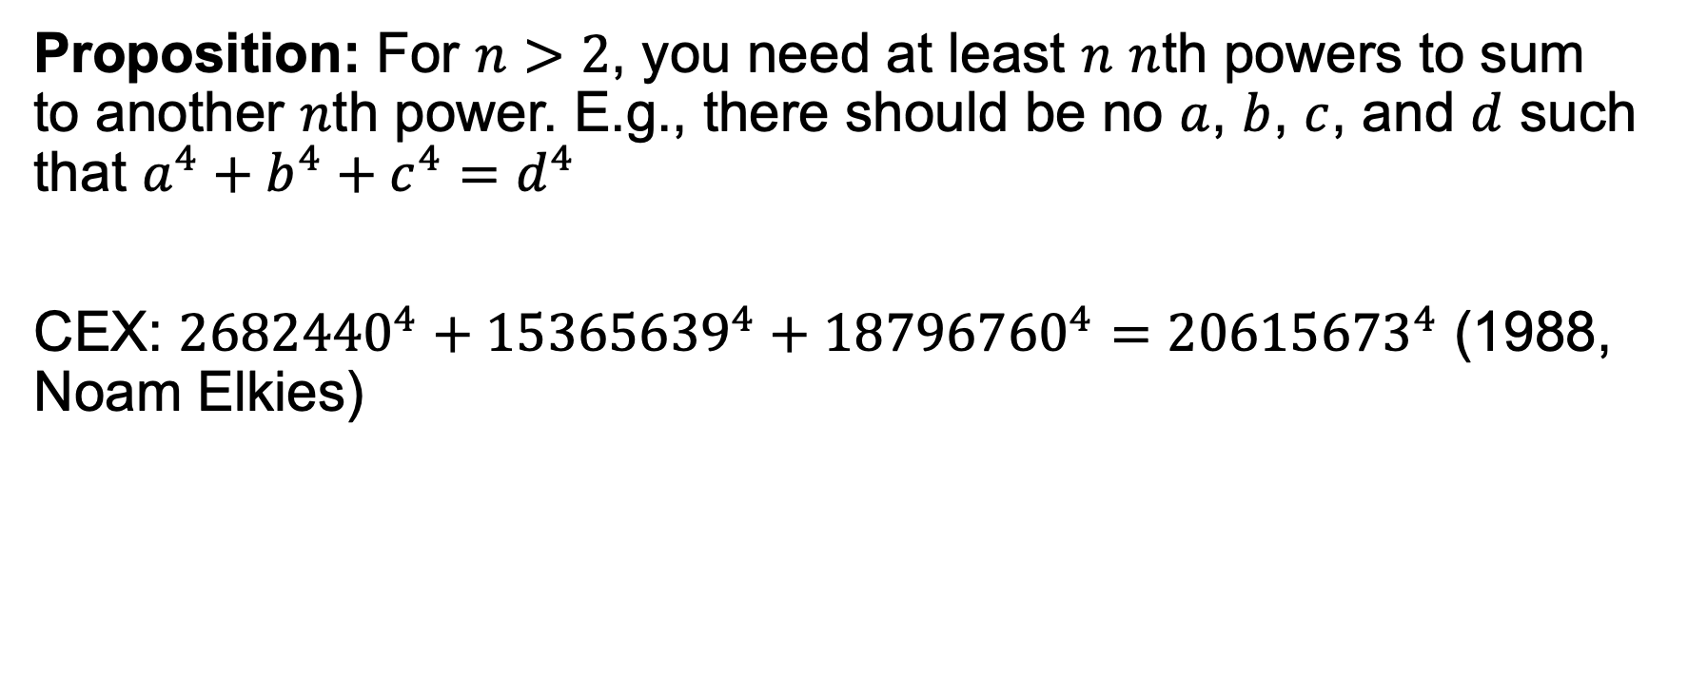
Euler’s Sum of Powers Conjecture (1769)
Proposition: For $n>2$, you need at least $n$ $n$th powers to sum to another $n$th power. E.g., there should be no $a$, $b$, $c$, and $d$ such that $a^{4}+b^{4}+c^{4}=d^{4}$
CEX: ${2682440}^{4}+{15365639}^{4}+{18796760}^{4}={20615673}^{4}$ (1988, Noam Elkies)

Slide 5

All Fermat Numbers are Prime (1640s)
Proposition: For all $n>1$, $F_{n}=2^{2^{n}}+1$ is prime.
CEX: $n=5$ $F_{5}=2^{32}+1=\text{4294967297}\text{ = }\text{641} \text{×} \text{6700417}$

Slide 6
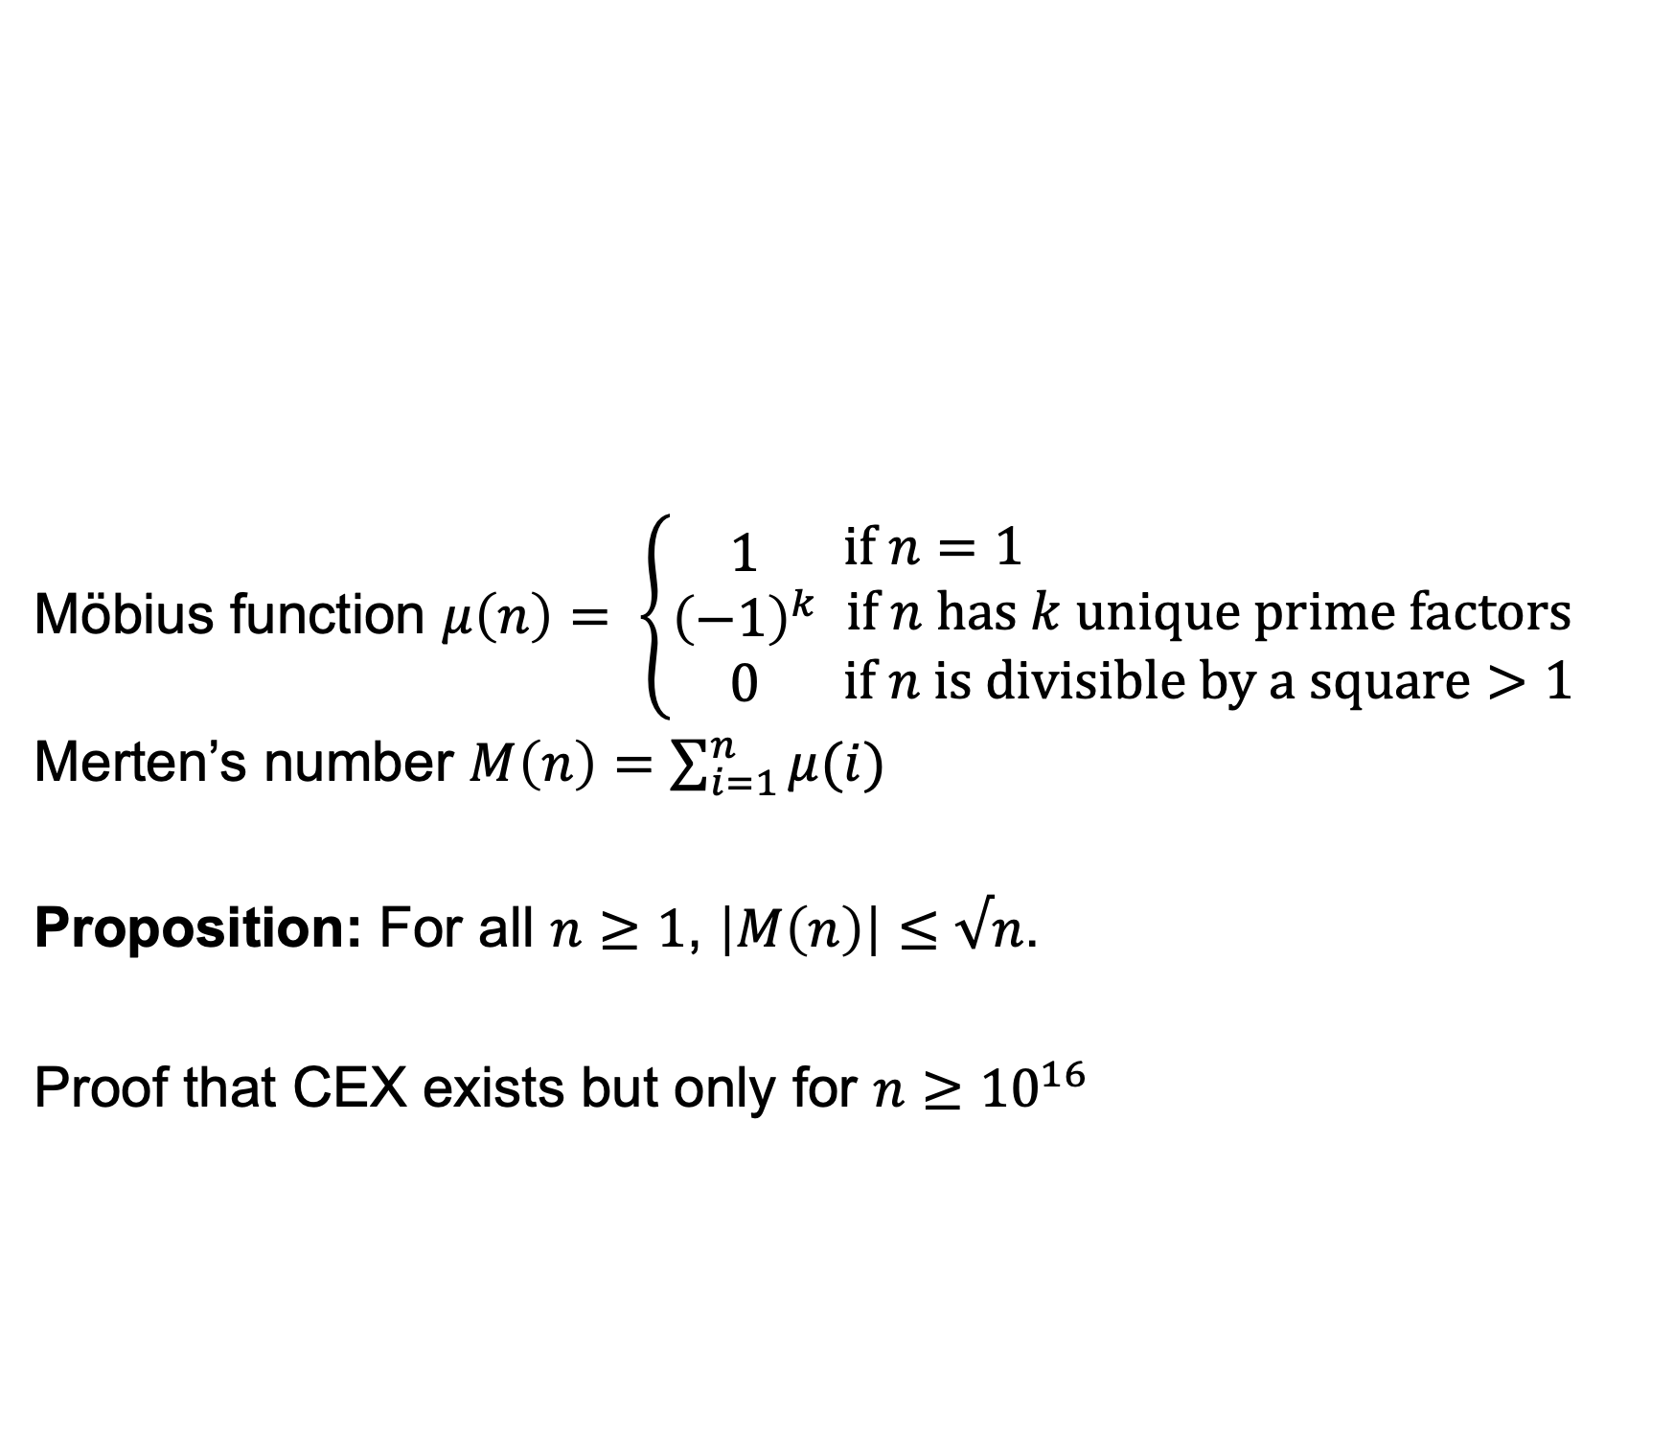
Merten’s Theorem (1832)
Möbius function $μ\left(n\right)= \left\{\begin{matrix}1 \\ {\left(−1\right)}^{k} \\ 0\end{matrix} \begin{matrix}if n=1 \\ if n has k unique prime factors \\ if n is divisible by a square>1\end{matrix}\right.$
Merten’s number $M\left(n\right)=\sum_{i=1}^{n}{μ(i)}$
Proposition: For all $n≥1$, $\left|M\left(n\right)\right|≤√n$.
Proof that CEX exists but only for $n≥{10}^{16}$

Slide 7
Group Exercises
Form groups of 3-4

