Slide 1
Proofs January 23, 2026
CSCI 246: Discrete Structures
Textbook Reference: Ch 1. Sec 5

Slide 2
Agenda
Review and Q&A (~5 minutes)
Lecture (~ 10 minutes)
Group Exercise (~25 minutes)
Discussion (~10 minutes)

Slide 3
If-then Statements
A | B | If A, then B
True | True | True
True | False | False
False | True | True
False | False | True
If hypothesis, then conclusion.
If pigs can fly, then I am the President.
If the moon is made of cheese, then every integer is prime.
If 1 is even, then P = NP.
If 2 = 3, then I have a pet unicorn.
Assumption about the world.
A fact derived from assumption.

Slide 4

If and only If Statements
A if and only if B
A exactly when B
(If A, then B) and (If B, then A)
$$≡$$
A | B | A iff B
True | True | True
True | False | False
False | True | False
False | False | True
$$≡$$

Slide 5
Proofs

Slide 6
Proof
Definition: An essay that incontrovertibly shows that a statement is true.

Slide 7
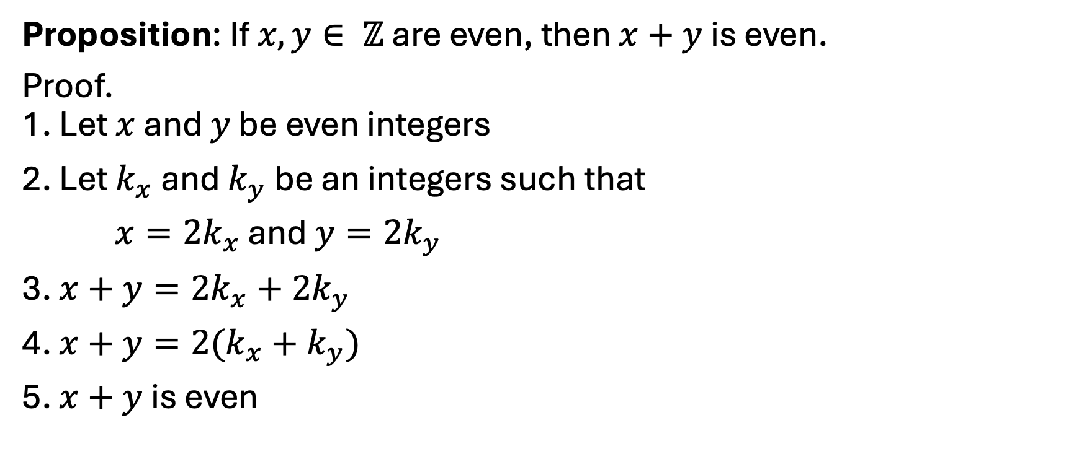
Sum of even integers is even
Proposition: If $x, y∈ ℤ$ are even, then $x+y$ is even.
Proof. 1. Let $x$ and $y$ be even integers
2. Let $k_{x}$ and $k_{y}$ be an integers such that
$x=2k_{x}$ and $y=2k_{y}$
3. $x+y=2k_{x}+2k_{y}$
4. $x+y=2(k_{x}+k_{y})$
5. $x+y$ is even
(by hypothesis)
(by 1 & Definition of even)
(by 2 & reflexivity of =)
(by 3 & simplification)
(by 4 & Definition of even)

Slide 8
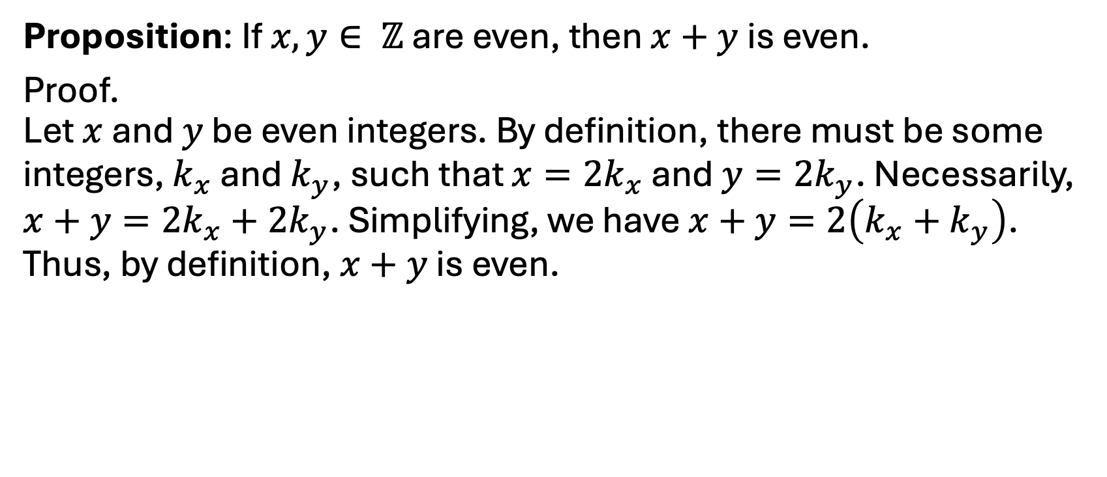
Sum of even integers is even
Proposition: If $x, y∈ ℤ$ are even, then $x+y$ is even.
Proof. Let $x$ and $y$ be even integers. By definition, there must be some integers, $k_{x}$ and $k_{y}$, such that $x=2k_{x}$ and $y=2k_{y}$. Necessarily, $x+y=2k_{x}+2k_{y}$. Simplifying, we have $x+y=2\left(k_{x}+k_{y}\right)$. Thus, by definition, $x+y$ is even.

Slide 9
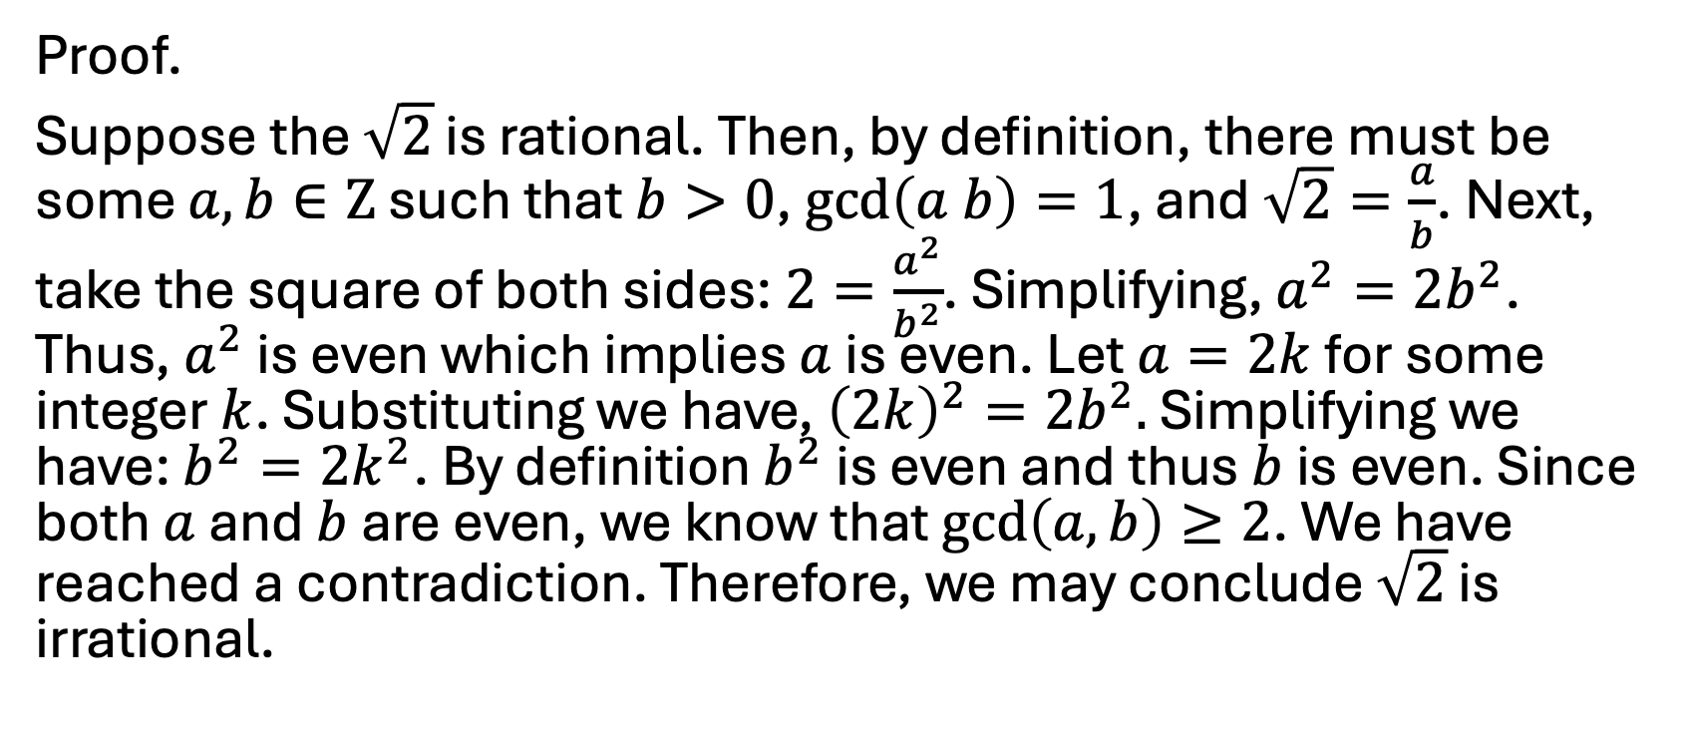
The square root of 2 is irrational.
Proof.
Suppose the $\sqrt{2}$ is rational. Then, by definition, there must be some $a, b∈Ζ$ such that $b>0$, $\gcd\left(a b\right)=1$, and $\sqrt{2}=\frac{a}{b}$. Next, take the square of both sides: $2=\frac{a^{2}}{b^{2}}$. Simplifying, $a^{2}=2b^{2}$. Thus, $a^{2}$ is even which implies $a$ is even. Let $a=2k$ for some integer $k$. Substituting we have, ${\left(2k\right)}^{2}=2b^{2}.$ Simplifying we have: $b^{2}=2k^{2}$. By definition $b^{2}$ is even and thus $b$ is even. Since both $a$ and $b$ are even, we know that $\gcd\left(a, b\right)≥2$. We have reached a contradiction. Therefore, we may conclude $\sqrt{2}$ is irrational.

Slide 10
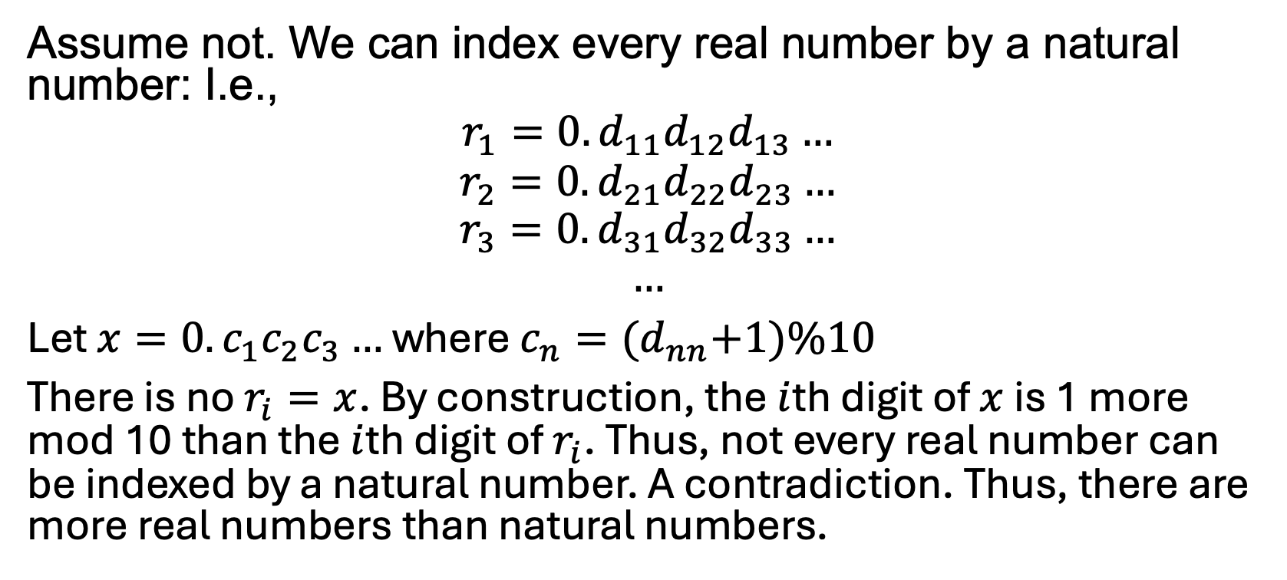

$$\left|ℝ\right|> \left|ℕ\right|$$
Assume not. We can index every real number by a natural number: I.e.,
$$r_{1}=0.d_{11}d_{12}d_{13}…$$
$$r_{2}={0.d}_{21}d_{22}d_{23}…$$
$$r_{3}={0.d}_{31}d_{32}d_{33}…$$
$$…$$
Let $x=0.c_{1}c_{2}c_{3}…$ where $c_{n}={(d}_{nn}+1)\%10$
There is no $r_{i}=x$. By construction, the $i$th digit of $x$ is 1 more mod 10 than the $i$th digit of $r_{i}$. Thus, not every real number can be indexed by a natural number. A contradiction. Thus, there are more real numbers than natural numbers.

Slide 11
Group Exercises
Form groups of 3-4

