Slide 1
Definition January 16, 2026
CSCI 246: Discrete Structures
Textbook Reference: Ch 1. Sec 3

Slide 2
Agenda
Lecture and Q&A (~ 5 minutes)
Group Exercise (~20 minutes)
Discussion (~25 minutes)

Slide 3

Natural Numbers
Defintion. The natural numbers, denoted by ℕ, is the set
$$ℕ≝\left\{1, 2, 3, …\right\}$$
Continuing forever
Some definitions also include 0

Slide 4

Whole Numbers
Definition. The set of whole numbers, denoted by 𝕎, is the set
$$\text{𝕎} ≝\left\{0, 1, 2, 3, …\right\}$$

Slide 5

Integers
Definition. The set of integers, denoted by ℤ, is the set
$$\text{ℤ}≝\left\{…, −3, −2, −1, 0, 1, 2, 3, …\right\}$$

Slide 6
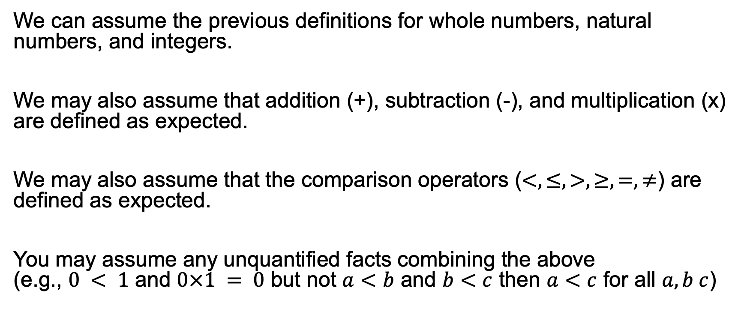
Assumptions
We can assume the previous definitions for whole numbers, natural numbers, and integers.
We may also assume that addition (+), subtraction (-), and multiplication (x) are defined as expected.
We may also assume that the comparison operators ($<, ≤, >, ≥, =, ≠$) are defined as expected.
You may assume any unquantified facts combining the above (e.g., $0 < 1$ and $0×1 = 0$ but not $a<b$ and $b<c$ then $a<c$ for all $a, b c$)

Slide 7
Group Exercises
Form groups of 3-4

Slide 8
Announcements
No class on Monday (MLK Jr. Day)
Assignment 1 will be released by start of class Jan. 21, 2026.

