Slide 1
CSCI 246 Discrete Structures
Instructor: Charlie Murphy

Slide 2
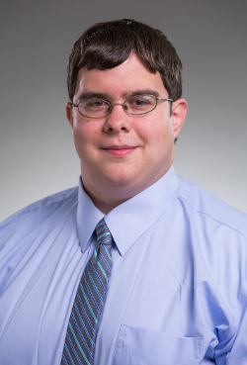
Instructor
Charlie Murphy
Charlie joined the Gianforte School of Computing as an Assistant Professor in Spring 2026. Previously, he was an Applied Scientist at Amazon. Before Amazon, he was a PostDoctoral Researcher at UW-Madison. He received his MA and PhD from Princeton University and BS from Ohio University (also the Bobcats!).

Slide 3
Instructor
Office Hours: MWF 1510-1600
Office Location: Barnard 344
Email: charlie.murphy1@montana.edu
Research Areas: programming languages, formal methods, automated reasoning, program synthesis and verification, and logic

Slide 4
Course Description
This course covers:
logic
discrete probability
recurrence relations
Boolean algebra
sets
relations
Counting
Functions
Maps
Big-O notation
proof techniques:
by induction
by contradiction

Slide 5
Course Outcomes
Apply formal proof techniques, including mathematical induction and proof by contradiction.
Use algorithmic complexity to compare different program designs for a problem.
Solve problems that require logic, sets, combinations, permutations and functions.
Solve problems that require discrete probability.
Solve problems that use basic graph theory.

Slide 6
Why should we care?
Math forms the core of Computer Science:
Machine Learning & Data Analysis: probability, statistics, logic, graph theory
Automated Reasoning: logic, graph theory, probability
Networking & Distributed Systems: graph theory, counting, sets, relations
Hardware: Boolean algebra, logic, graph theory

Slide 7
This course gives you a mathematical foundation to explore all areas of computer science.

Slide 8
Communication Policy
Individual communication will be conducted via email.
Course Announcements / Broadcasts will be made via Canvas (or in some cases NavMSU).

Slide 9
Course Resources
Canvas:
Used to reporting and tracking grades throughout the semester.
Used for course Announcements
Course Website:
Linked from canvas homepage
Official Syllabus and Course Schedule

Slide 10
Syllabus & Policy Review
https://www.cs.montana.edu/users/murphy/courses/csci246/spring26.html

Slide 11
Tips on Learning
Read the suggested readings before each course meeting.
Use active reading; have a pencil and paper to try problems sketch ideas, work through proofs.
Attend all course meetings:
Participate in lectures
Work through in class problems
Be okay with struggling / not knowing answers
Attempt homework problems before discussing with others.
Make use of office hours and other campus resources!

