Slide 1
Game engine
A feature presentation by: Jan and Jess

Slide 2
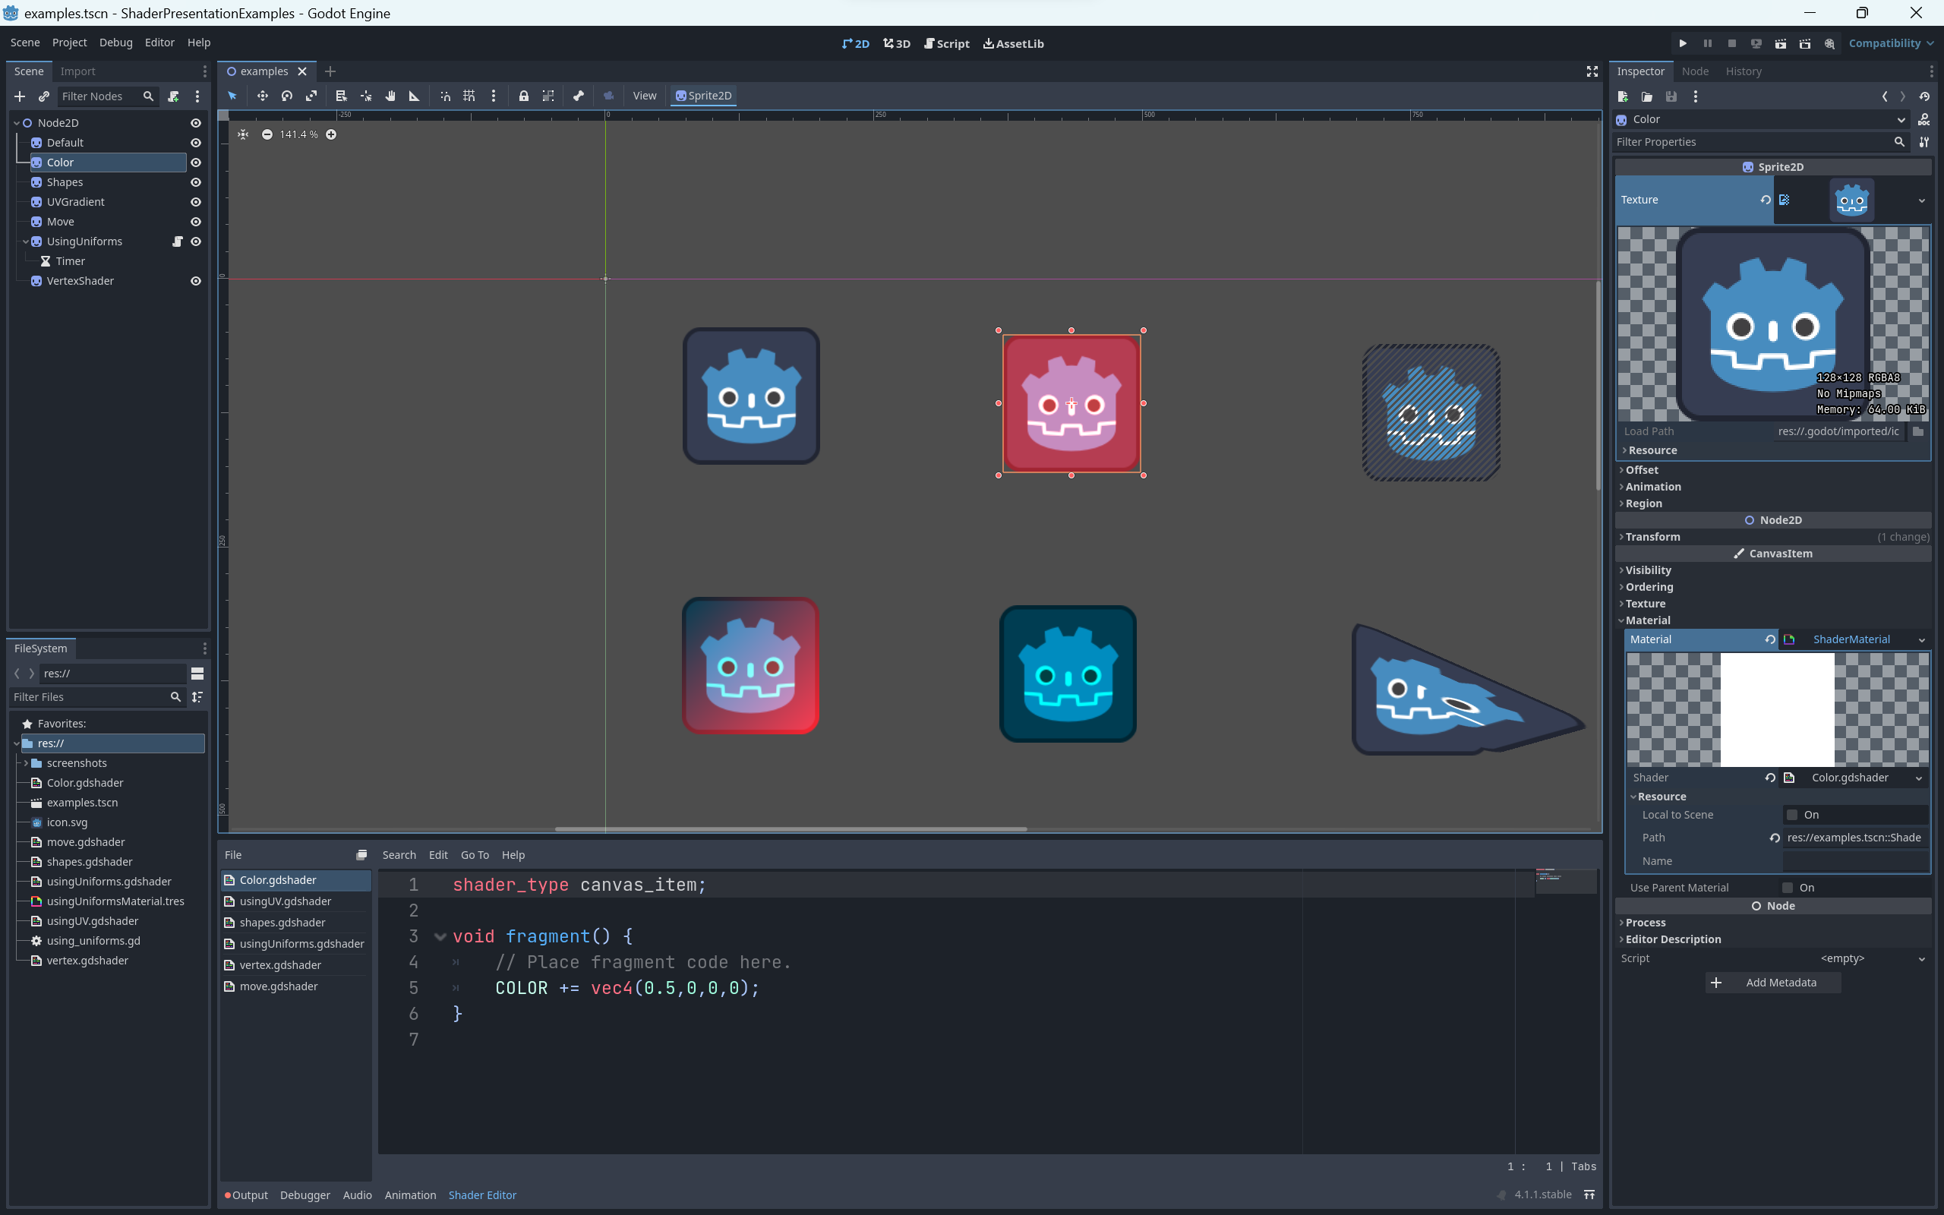
WHAT
ARE
THEY?
SHADERS

Slide 3
SHADERS
They are a way to create visual effects by affecting the color and shape of a material.¹
WHAT
ARE
THEY?

Slide 4
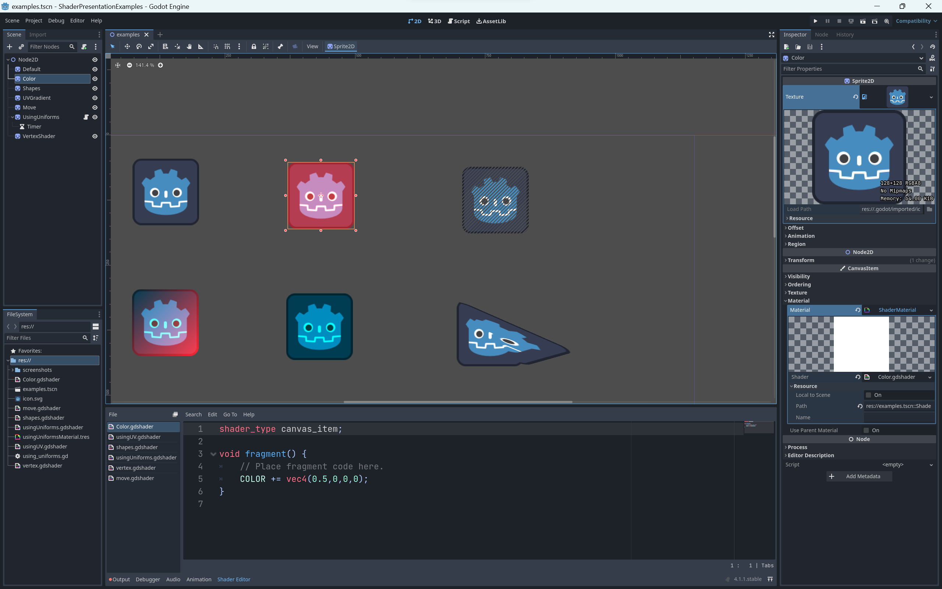
What can they do:
Position vertices
Compute colors
Compute Lighting
Math
Alles Sehr Schnell¹
SHADERS
They are a way to create visual effects by affecting the color and shape of a material.¹
The Book of Shaders by Patricio Gonzalez Vivo & Jen Lowe ⁴

Slide 5
SHADERS
What can they do:
Position vertices
Compute colors
Compute Lighting
Math
Alles Sehr Schnell¹
The Book of Shaders by Patricio Gonzalez Vivo & Jen Lowe ⁴
They are a way to create visual effects by affecting the color and shape of a material.

Slide 6
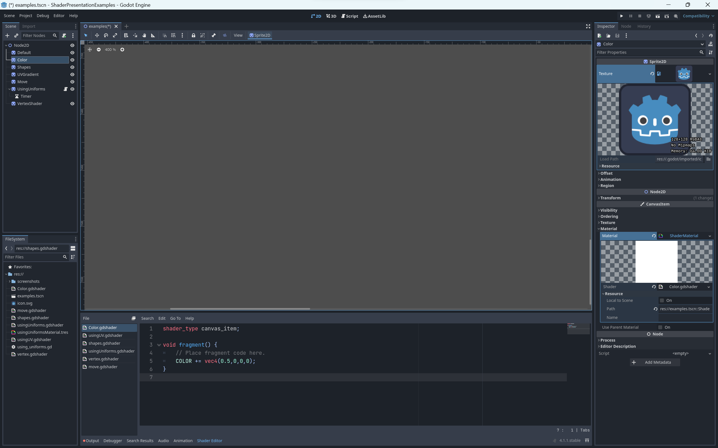
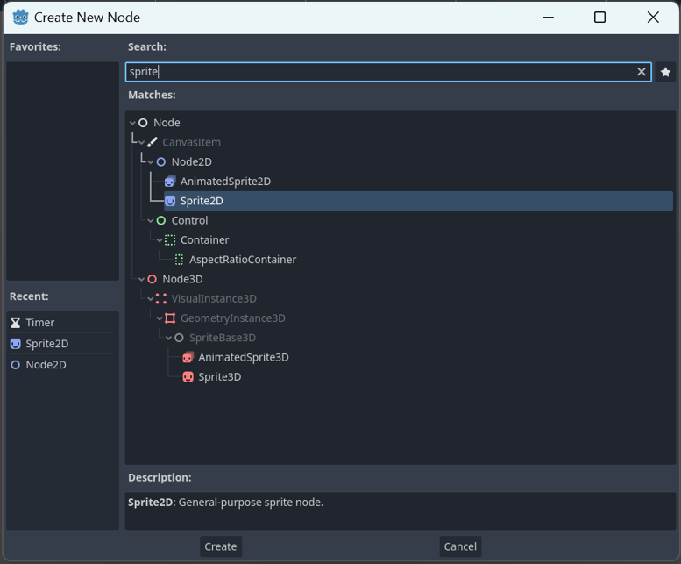
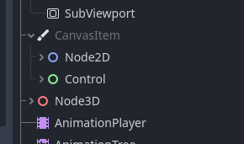
HOW?
Let’s show you…
NOTE:
Must be objects derived from a CanvasItem

Slide 7
NOTE:
Must be objects derived from a CanvasItem

Slide 8
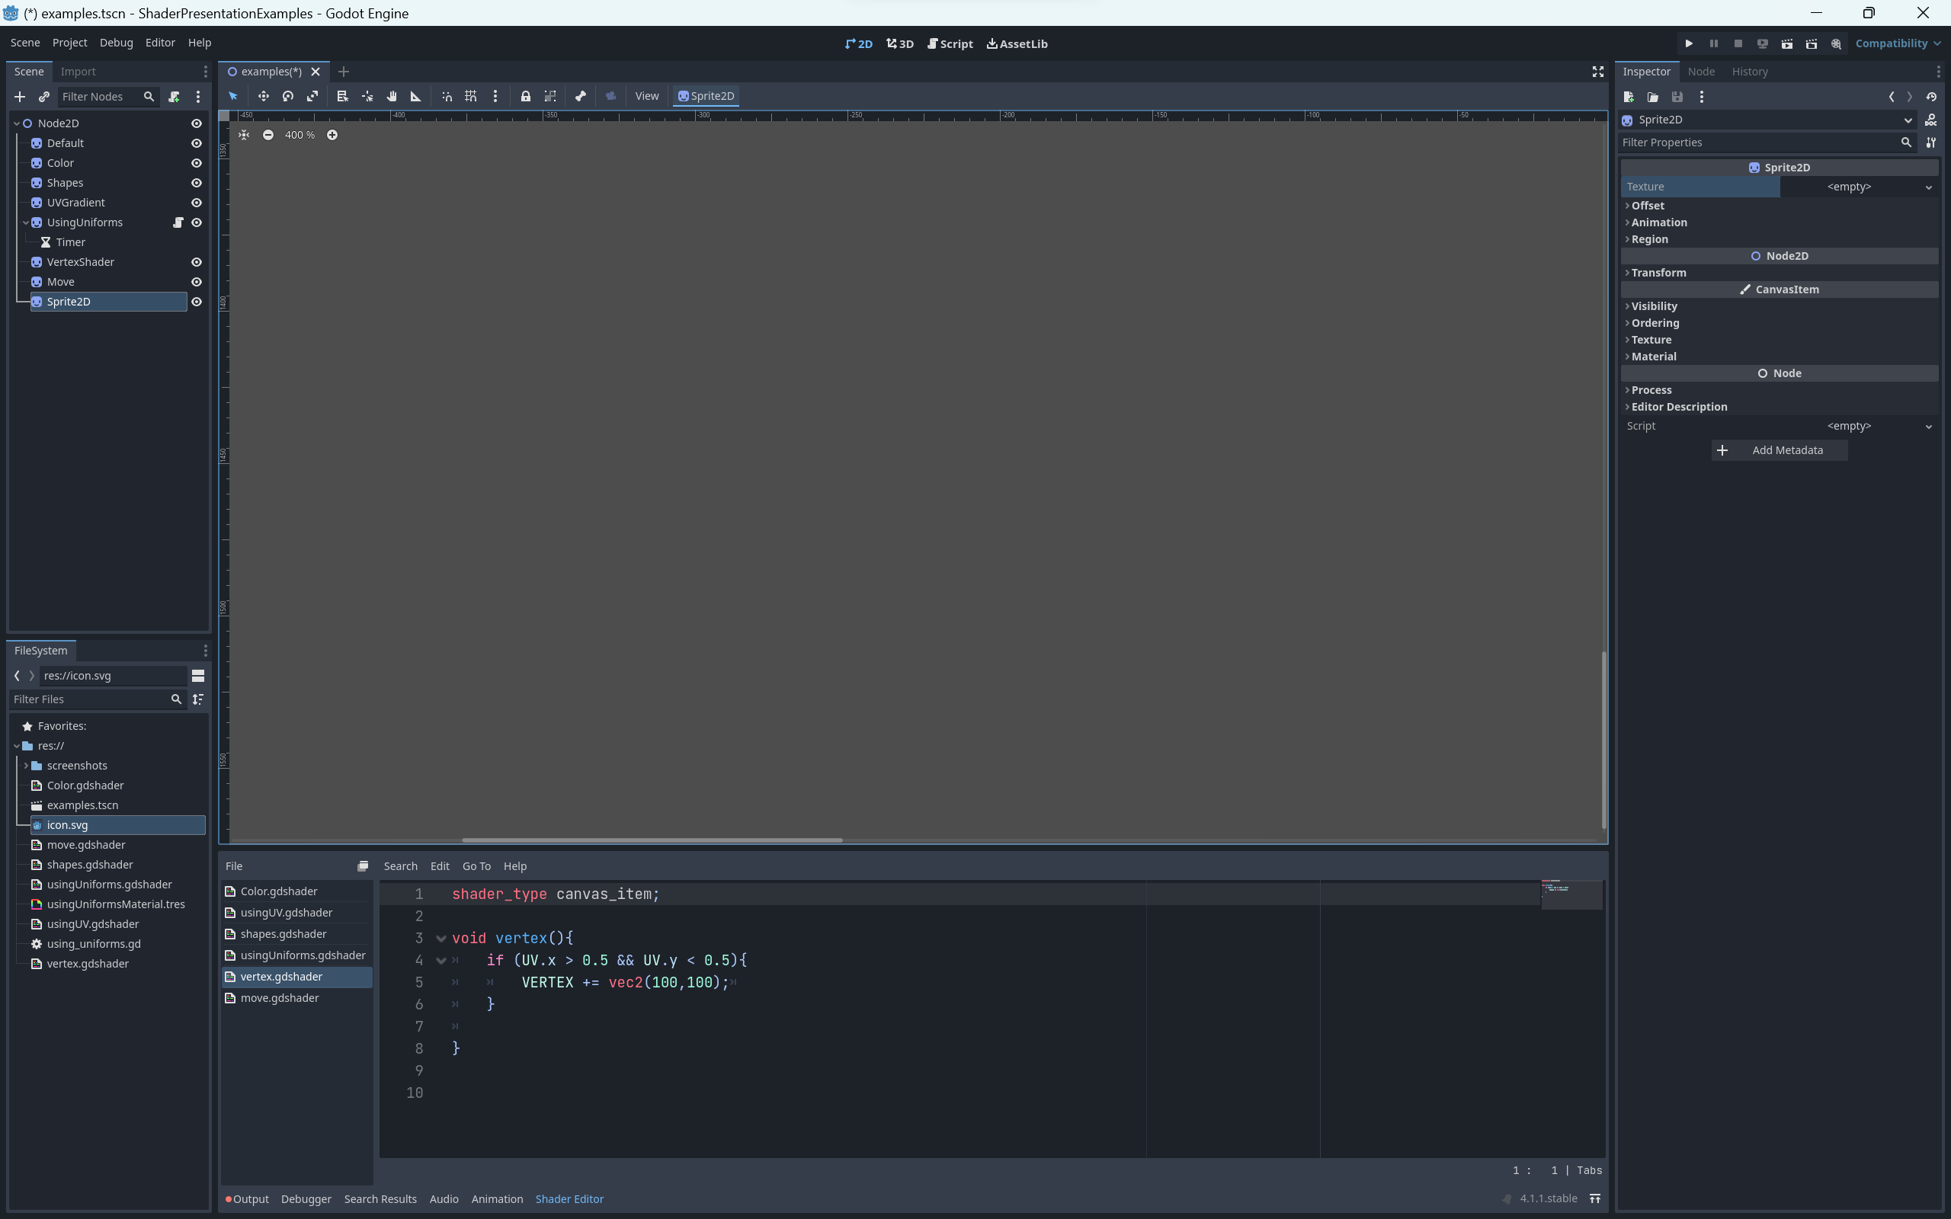
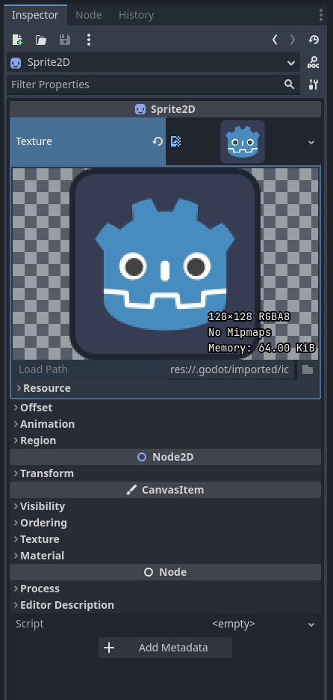
NOTE:
Must be objects derived from a CanvasItem

Slide 10
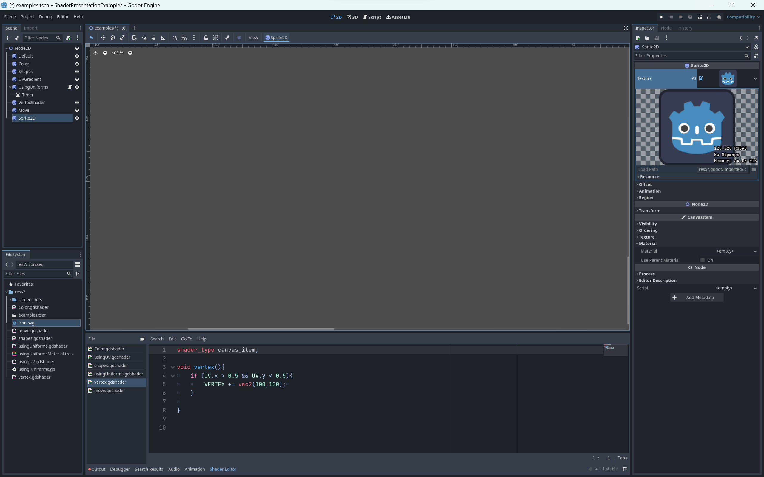
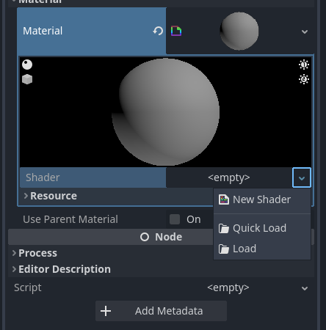
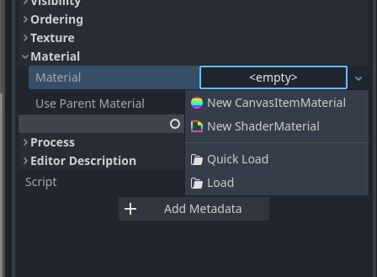
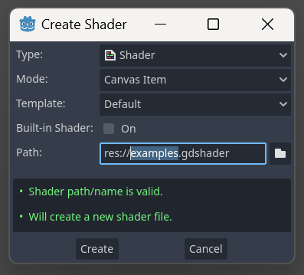

Slide 14
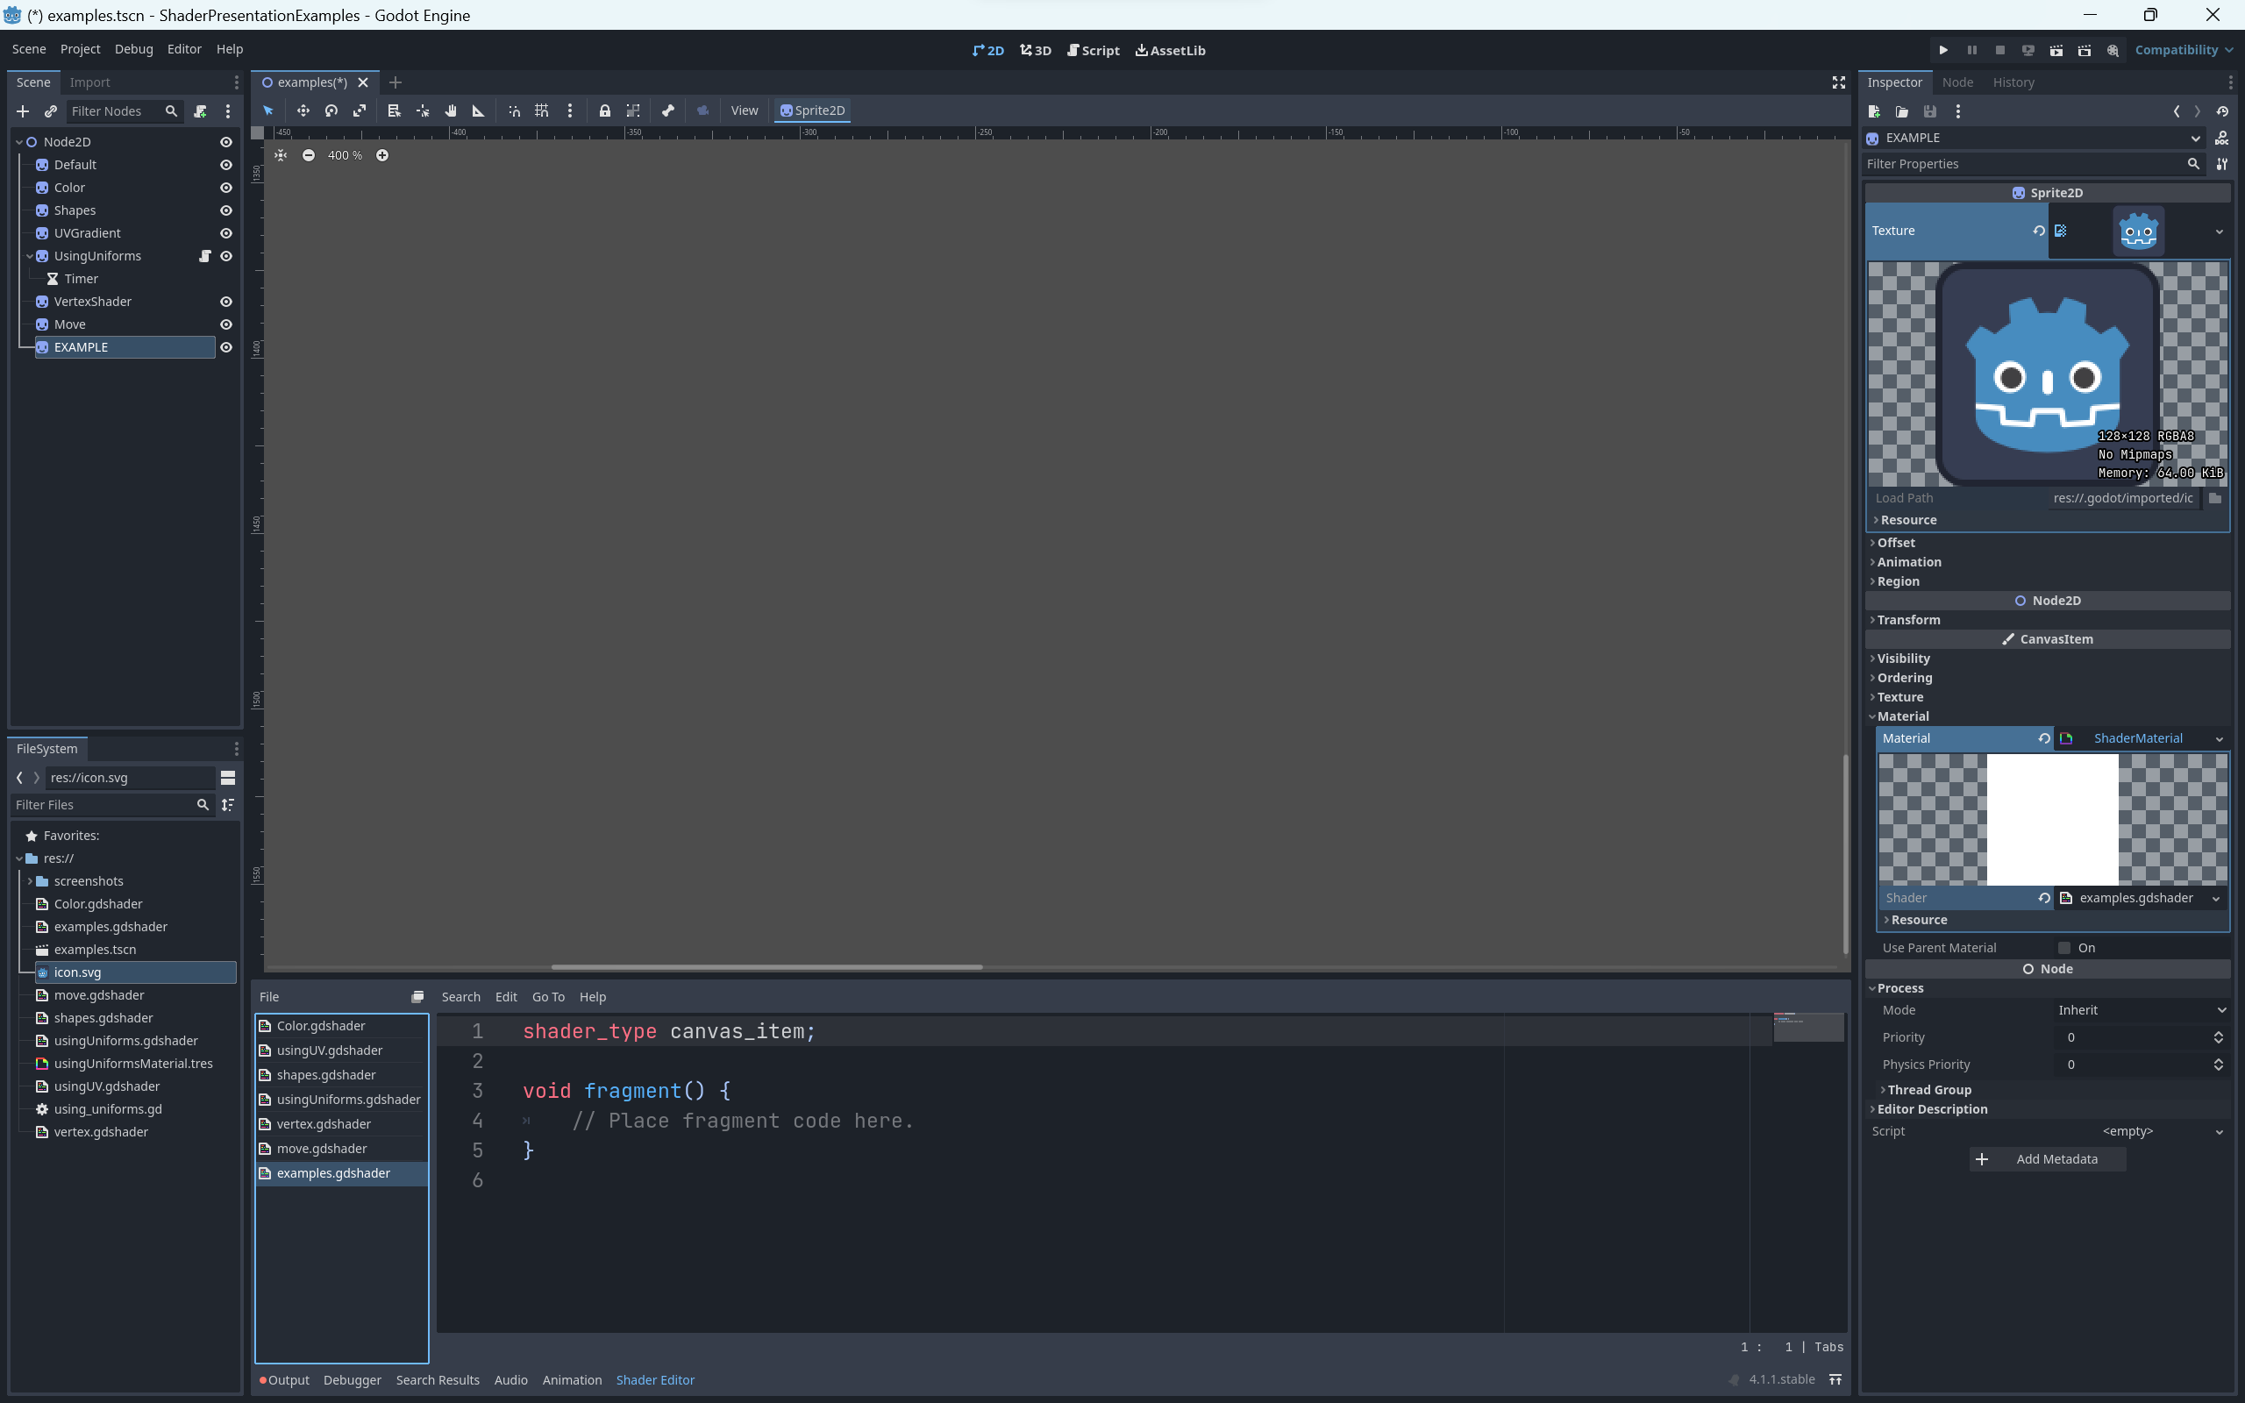
WRITING CODE??

Slide 15
WRITING CODE??

Slide 16
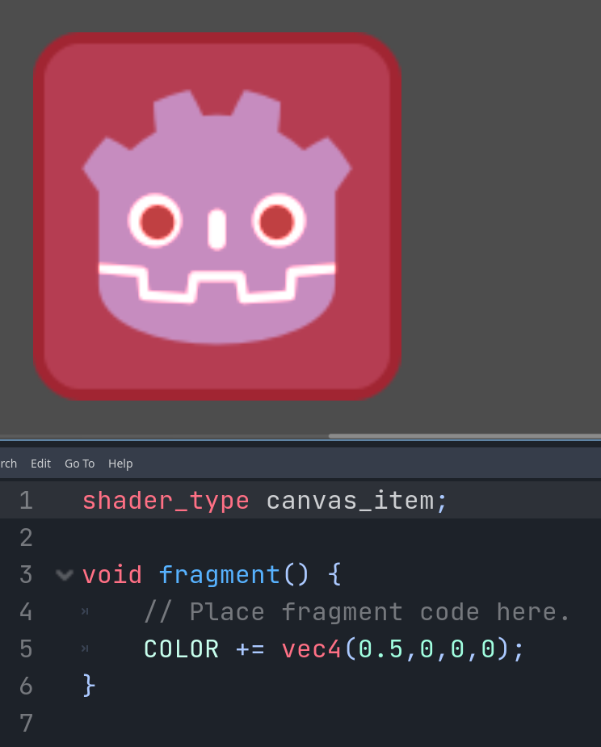
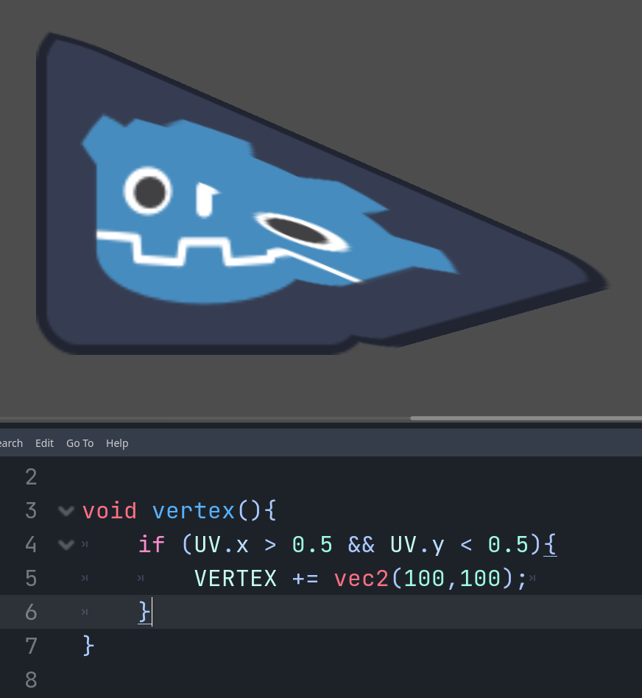
WARNING!
- Syntax is similar to what most GLSL shader compilers support (which in turn is similar to the C/C++ preprocessor).¹
WRITING CODE??

Slide 17
EXAMPLES
FUNCTIONS
vertex()
Fragment()

Slide 18
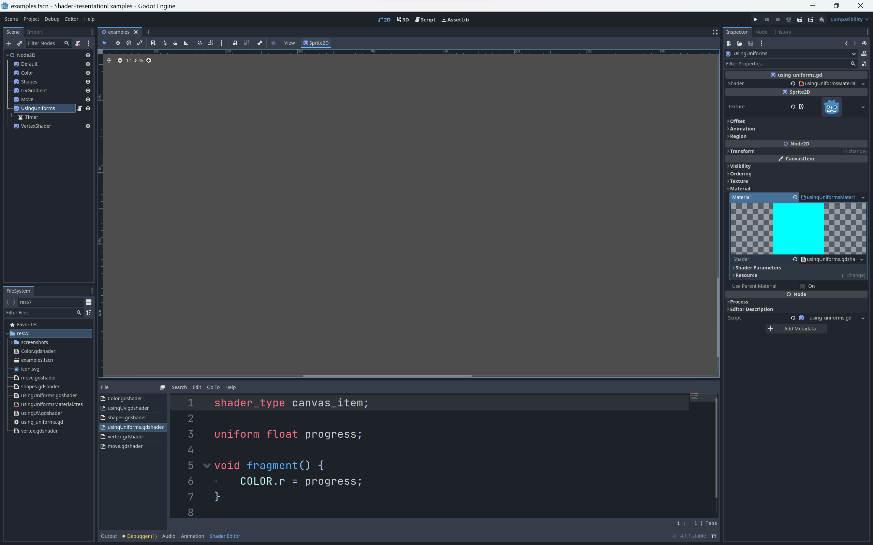
FUNCTIONS
EXAMPLES

Slide 19
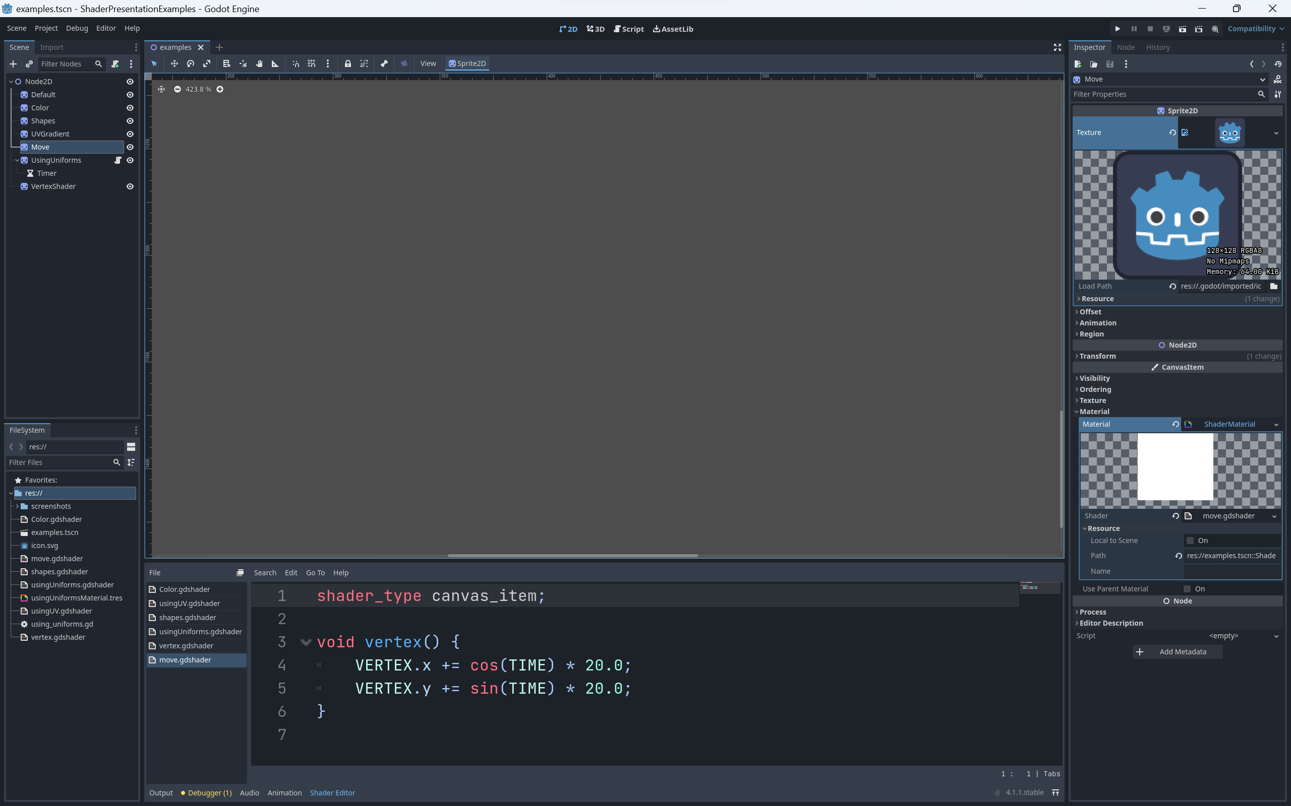
EXAMPLES

Slide 20
EXAMPLES ³
WHO CARES?

Slide 21
WHO CARES?
YOU SHOULD
Here’s why…

Slide 22
WHO CARES?
YOU SHOULD
Here’s why…

Slide 23
Performant Dynamic Graphic

Slide 24
Think of a visual effect and if you can find the math to implement the design…You can make a sweet shader.

Slide 25
CONCLUSION
WHAT
DID WE
LEARN?
WHAT SHADERS ARE?
HOW TO CREATE A SHADER
DIFFERENT TYPES OF SHADERS
DOCUMENTATION IS HELPFUL
LASTLY…
SHADERS ARE VERY COOL.

Slide 26
SHADERS
WHAT
DID WE
LEARN?
WHAT SHADERS ARE?
HOW TO CREATE A SHADER
DIFFERENT TYPES OF SHADERS
DOCUMENTATION IS HELPFUL
LASTLY…
SHADERS ARE VERY COOL.

Slide 27
SHADERS
WHAT
DID WE
LEARN?
WHAT SHADERS ARE?
HOW TO CREATE A SHADER
DIFFERENT TYPES OF SHADERS
DOCUMENTATION IS HELPFUL
LASTLY…
SHADERS ARE VERY COOL.

Slide 28
SHADERS
WHAT
DID WE
LEARN?
WHAT SHADERS ARE?
HOW TO CREATE A SHADER
DIFFERENT TYPES OF SHADERS
DOCUMENTATION IS HELPFUL
LASTLY…
SHADERS ARE VERY COOL.

Slide 29
SHADERS
WHAT
DID WE
LEARN?
WHAT SHADERS ARE?
HOW TO CREATE A SHADER
DIFFERENT TYPES OF SHADERS
DOCUMENTATION IS HELPFUL
LASTLY…
SHADERS ARE VERY COOL.

Slide 30
SHADERS
WHAT
DID WE
LEARN?
WHAT SHADERS ARE?
HOW TO CREATE A SHADER
DIFFERENT TYPES OF SHADERS
DOCUMENTATION IS HELPFUL
LASTLY…
SHADERS ARE VERY COOL.

Slide 31
REFERENCES
https://docs.godotengine.org/en/stable/tutorials/shaders/introduction_to_shaders.html ¹
https://www.youtube.com/watch?v=xoyk_A0RSpI ²
https://www.shadertoy.com ³
https://thebookofshaders.com/ ⁴
https://godotshaders.com ⁵

Slide 32
Conclusion.
Lesson learned
Think of a visual effect and if you can find the math to implement the design…You can make a sweet shader.

