Slide 1
Programming in go:
Testing

Slide 2
Before we start…
How does testing in Go work?
Why is testing an important part of programming?

Slide 3
Testing in Go
Go is a versatile language with many helpful tools for all parts of developing good code and one of those tools is made for testing.
Go has a built-in testing command called go test and a package called testing which combine to give a minimal but complete testing experience.

Slide 4
Why is testing important?
Testing and quality assurance is a very important part of any software and a skill that every programmer should have.
There are many different types of tests made to test everything from small units of a program to large functions and programs as a whole.
Without testing even the largest most experienced companies such as Apple and Google would have lots of issues of bugs and problems with their software, that’s why most companies have quality assurance teams to go through and test software's with each update and make sure that these tests are kept up to date.

Slide 5
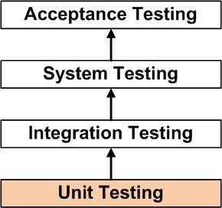
Different types of testing
Some of the main types of tests used for quality assurance work are:
Unit testing
Integration testing
System testing

Slide 6
Unit testing
Unit testing is the testing of an individual software component or module. It is typically done by the programmer and not by testers, as it requires detailed knowledge on the internal program design and code.

Slide 7
Integration Testing
Integration testing is the testing of all integrated modules to verify the combined functionality after integration.

Slide 8
System Testing
System testing is when the entire system is tested as per requirements. It’s a Black-Box type testing that is based on overall requirement specifications and covers all the combined parts if a system.

Slide 9
Writing tests in Go
Program to sum two integers:
package main
func Sum(x int, y int) int {
return x + y
}
func main() {
Sum(5, 5)
}
Unit test:
package main
import "testing“
func TestSum(t *testing.T) {
total := Sum(5, 5)
if total != 10 {
t.Errorf("Sum was incorrect, got: %d, want: %d.", total, 10) }
}

Slide 10
Characteristics of a Go test function:
The first and only parameter needs to be t *testing.T
It begins with the word Test followed by a word or phrase with a capital letter.
Calls t.Error or t.Fail to indicate failure
Must be saved in a file named something_test.go such as addition_test.go

Slide 11
Launching tests:
There are two ways to launch a test in Go:
Within the same directory as the test: Go test
By fully- qualified package name: go test (link to test or directory)

